Slide 1
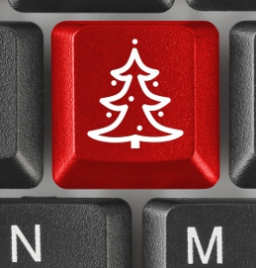
Advent of learning – Dr Grant Hair director of learning at the Derek Zoolander Center For Children Who Can't Read Good And Wanna Learn To Do Other Stuff Good Too
25 days of
tech fun
Dec 2020

Slide 2
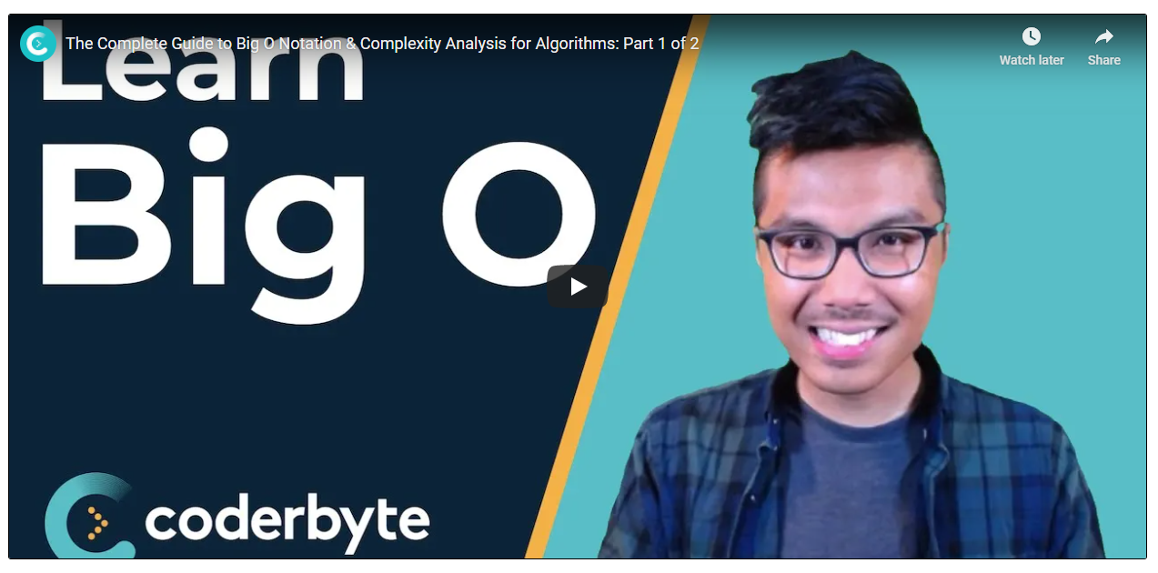
Day 1
https://coderbyte.com/video/the-complete-guide-to-big-o-notation-part-1-of-2

Slide 3

Day 2
https://www.youtube.com/c/Elfocrash/featured
C# Enterprise Videos

Slide 4
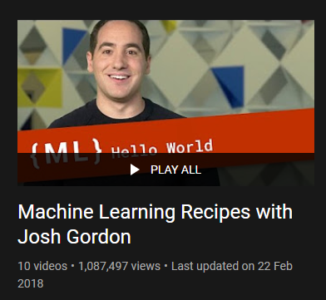
Day 3
https://www.youtube.com/playlist?list=PLOU2XLYxmsIIuiBfYad6rFYQU_jL2ryal

Slide 5
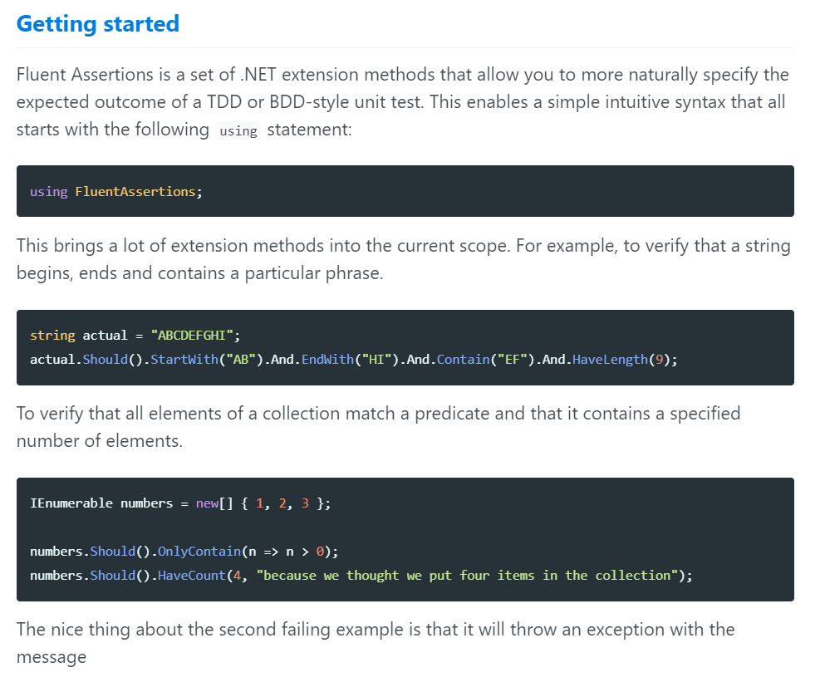
Day 4
https://fluentassertions.com/

Slide 6
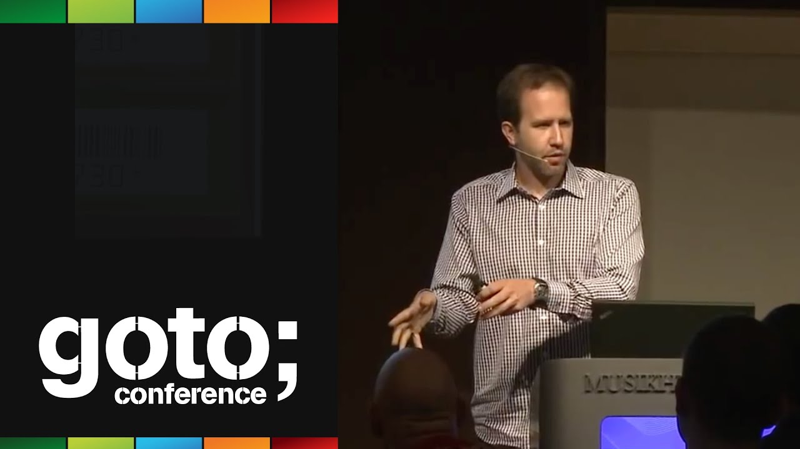
Day 5
https://www.youtube.com/watch?v=FS1mnISoG7U
GOTO 2012
Scaling Yourself
Scott Hanselman

Slide 7
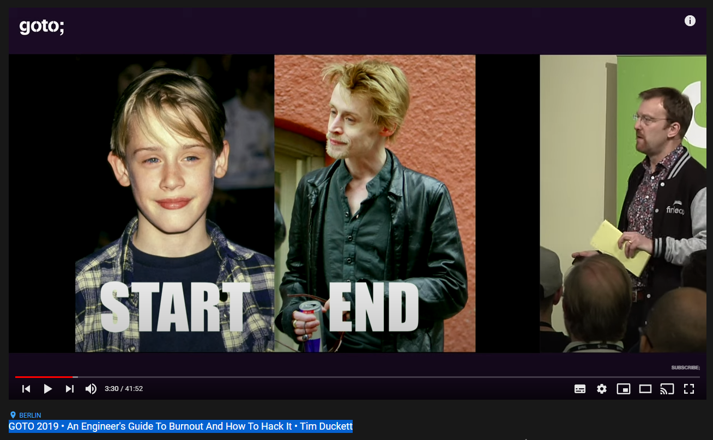
Day 6
https://youtu.be/jfQ5M6wXi2w
GOTO 2019
An Engineer's Guide To Burnout And How To Hack It
Tim Duckett

Slide 8
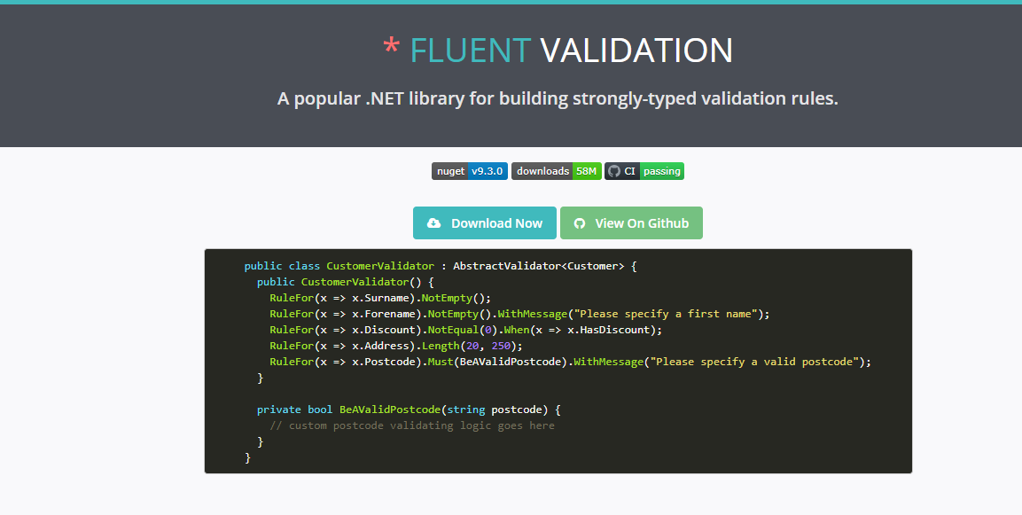
Day 7
https://fluentvalidation.net/

Slide 9

Day 8
https://dev.to/mahdi/using-graphql-net-client-in-net-5-56mf

Slide 10

Day 9
https://docs.microsoft.com/en-us/aspnet/core/grpc/?view=aspnetcore-5.0

Slide 11
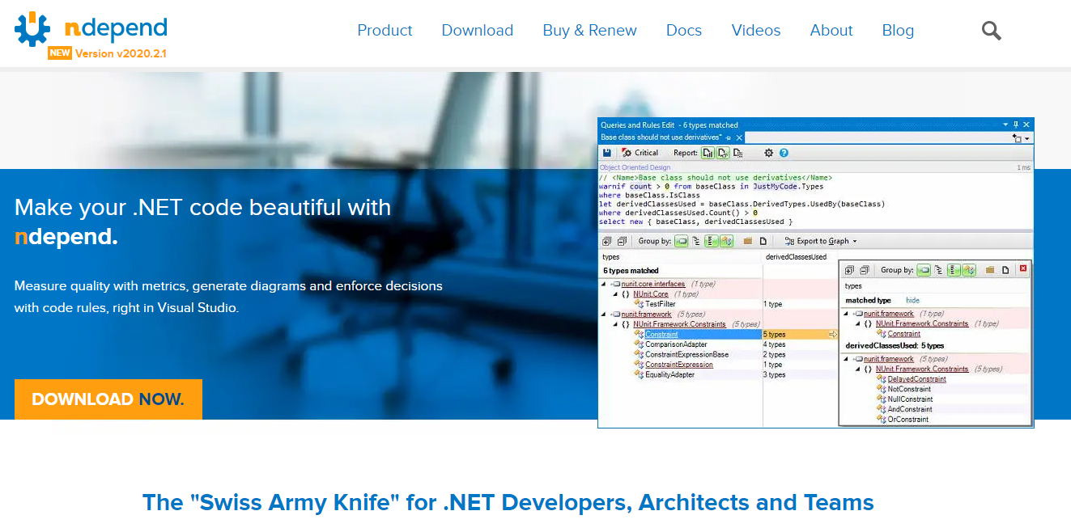
Day 10
https://www.ndepend.com/

Slide 12
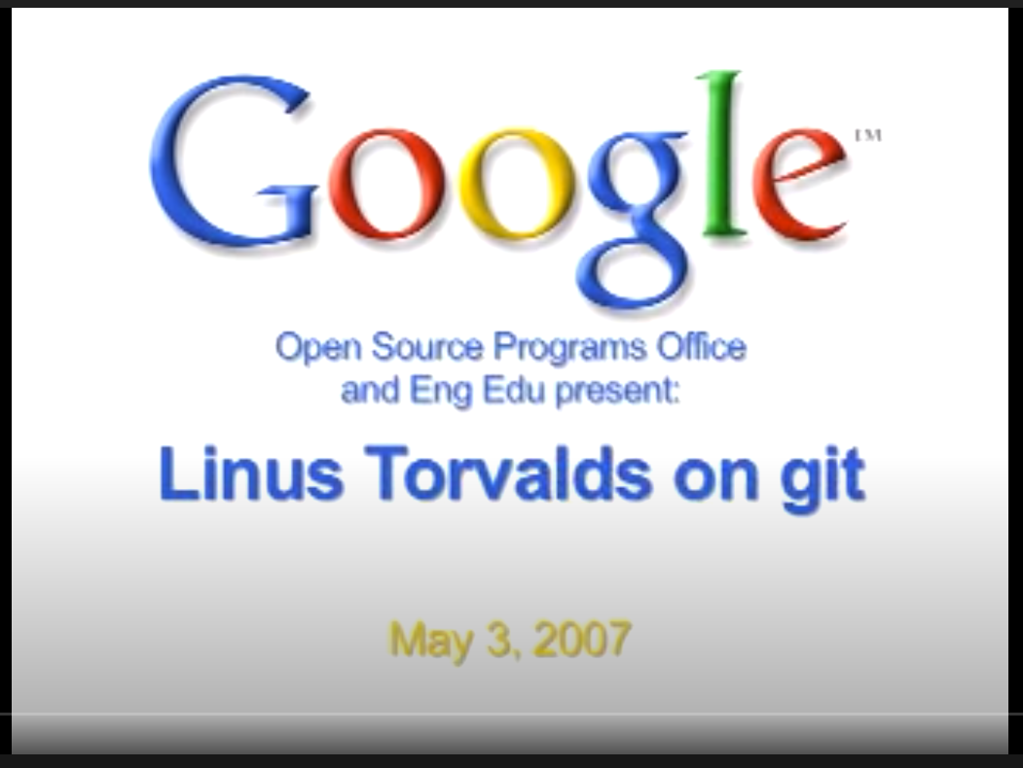
Day 11
https://www.youtube.com/watch?v=4XpnKHJAok8
He is a bit of a condescending dick throughout but turns out he was right
Also Dio has met this god like figure in real life so please do not ask him about it, unless you have 20 minutes. :D

Slide 13
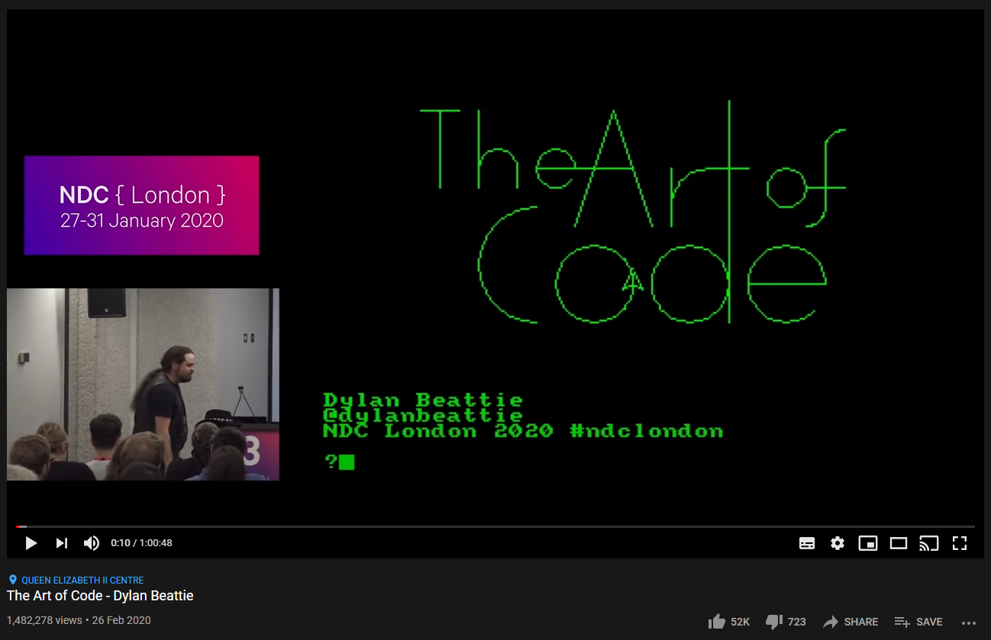
Day 12
https://youtu.be/6avJHaC3C2U

Slide 14
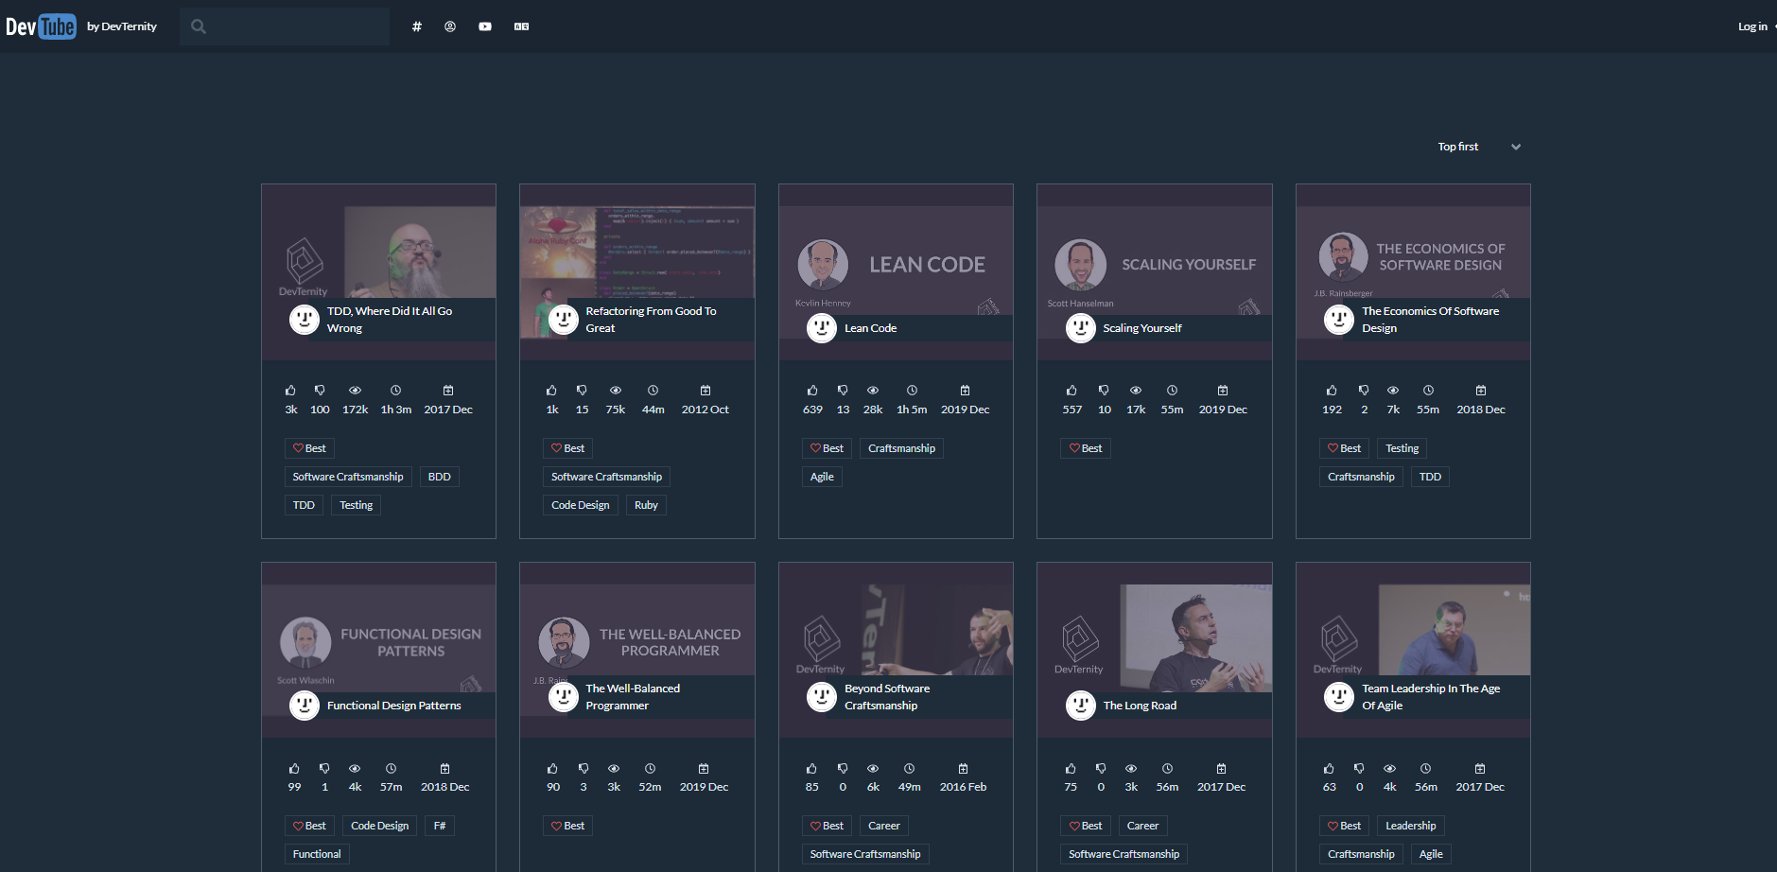
Day 13
https://dev.tube/
YouTube for developer conferences

Slide 15

Day 14
https://medium.com/@dabit3/full-stack-development-in-the-era-of-serverless-computing-c1e49bba8580

Slide 16
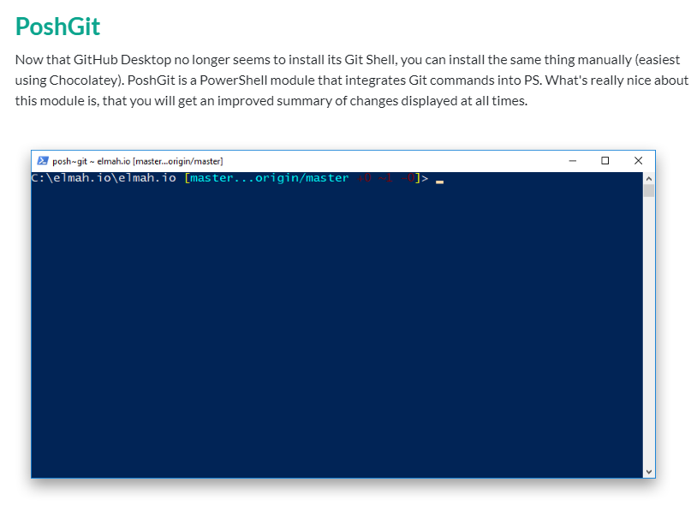
Day 15
https://github.com/dahlbyk/posh-git

Slide 17
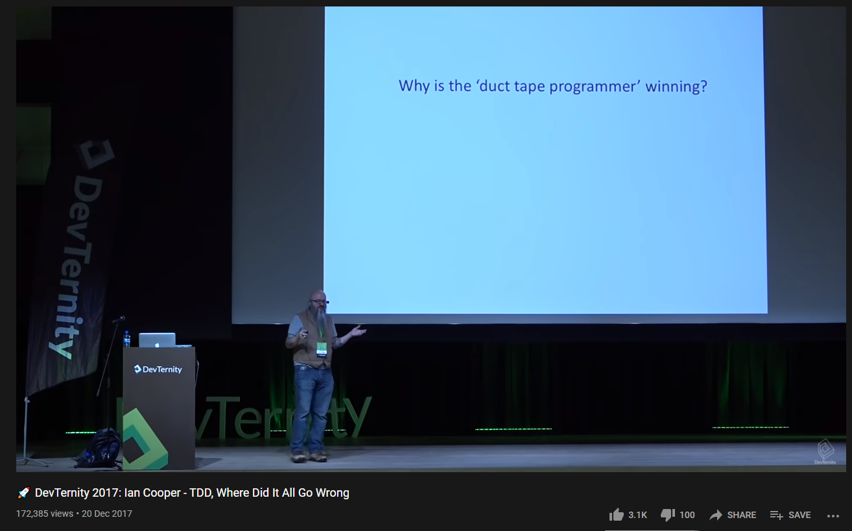
Day 16
https://www.youtube.com/watch?v=EZ05e7EMOLM

Slide 18
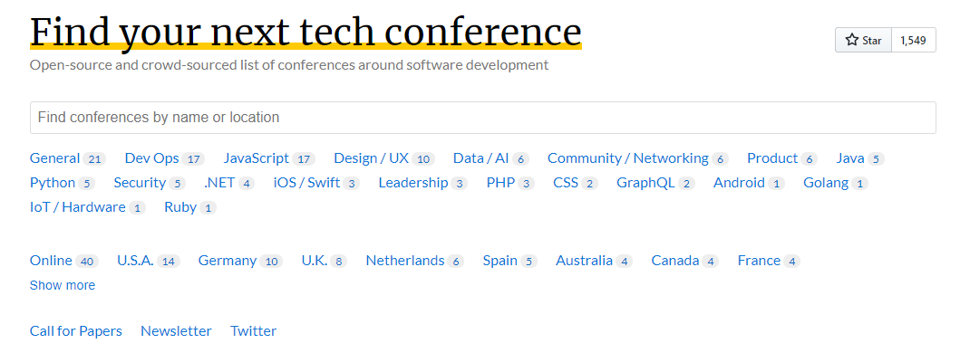
Day 17
https://confs.tech/

Slide 19
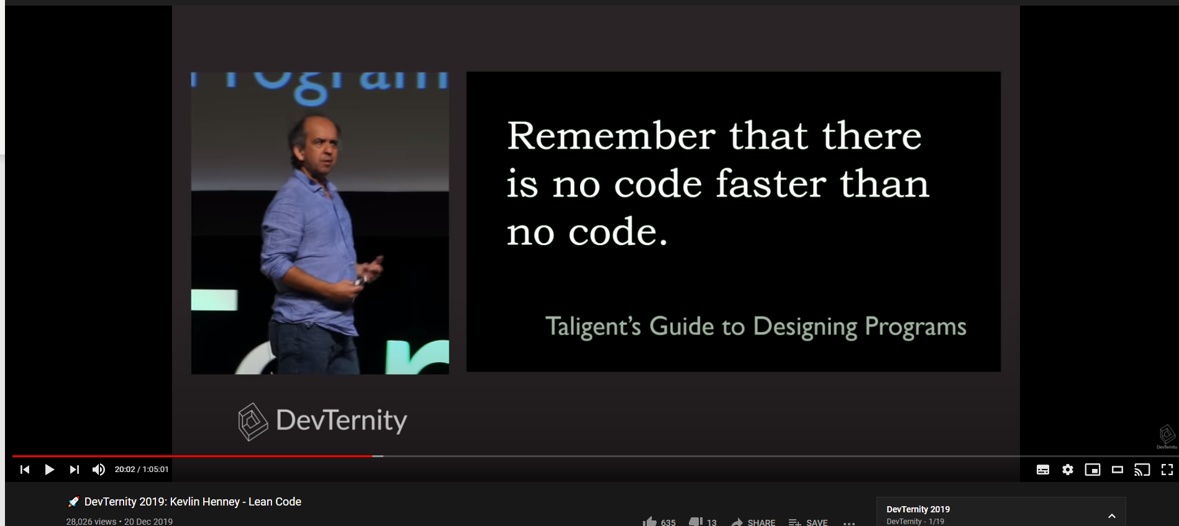
Day 18
https://youtu.be/-nWhH-4wWBU

Slide 20

Day 19
https://opensource.microsoft.com/projects

Slide 21

Day 20
https://svelte.dev/

Slide 22
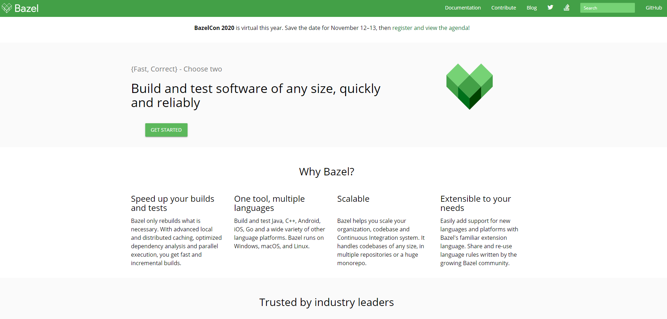
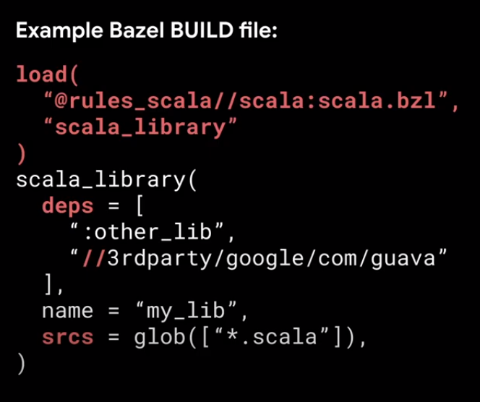
Day 21
https://bazel.build/
https://www.youtube.com/watch?v=Bmn5Ugp4r2I&list=PLxNYxgaZ8RseRybXNbopHRv6-wGmFr04n
BazelCon
https://www.syntaxsuccess.com/viewarticle/building-dotnet-with-bazel

Slide 23
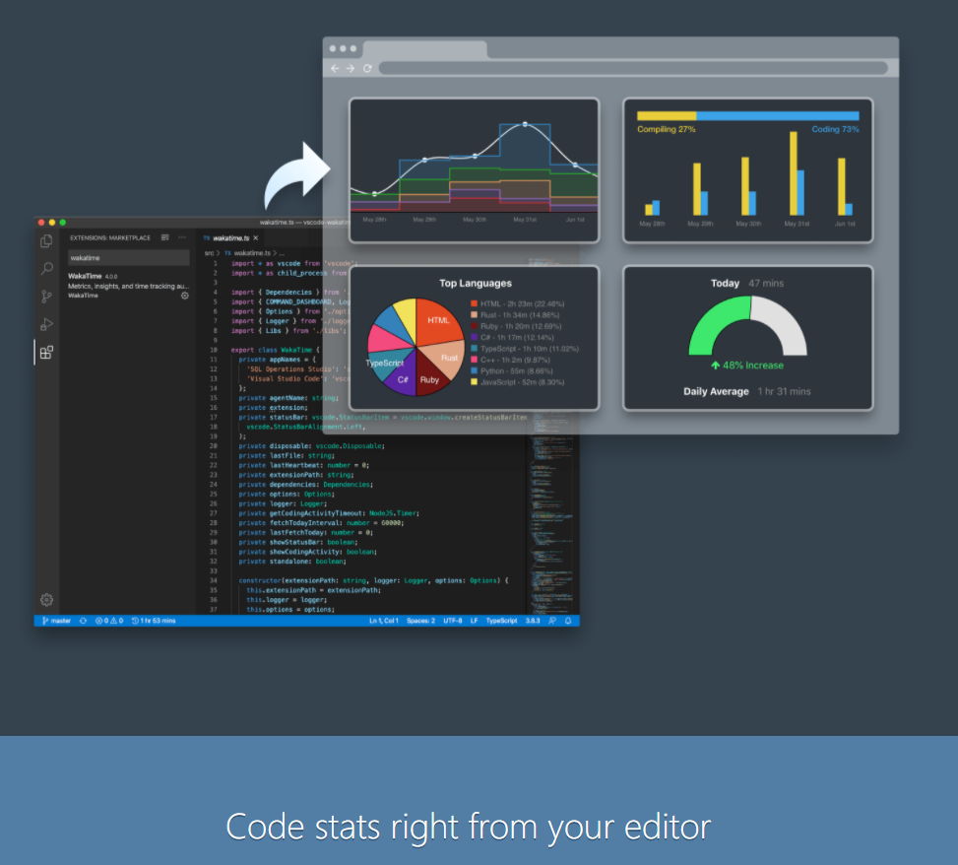
Day 22
https://wakatime.com/

Slide 24

Day 23
https://devblogs.microsoft.com/dotnet/introducing-support-for-brotli-compression/
https://github.com/google/brotli

Slide 25
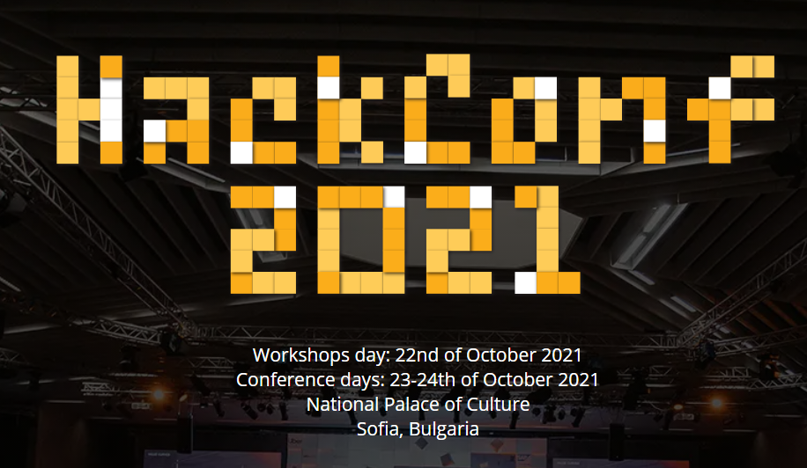
Day 24
https://hackconf.bg/

Slide 26
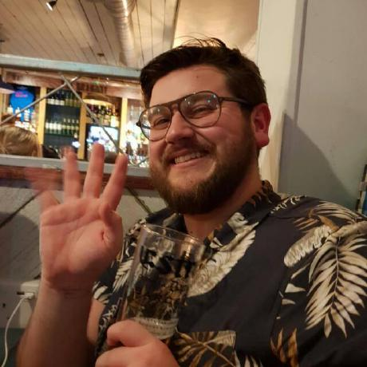
Day 25 – Feliz Navidad, καλά Χριστούγεννα, vesel božič, Nollaig Chridheil, Gleðileg jól, buon Natale, 메리 크리스마스, Весела Коледа, joyeux Noël, MERRY CHRISTMAS!!!!!!!!!!!!!
https://github.com/GrantHair5/TechnicalPresentations

